Slide 1
2. Algorithm Implementation and counting
1.1–1.2
Notes:
(2.1) Given a problem specification, determine the inputs, outputs and error conditions of the algorithmic solution to the problem
(2.2) Analyze algorithms by counting operations executed in the algorithm
(2.3) Develop algorithms involving iteration using a WHILE loop
(2.4) Count the number of operations executed in an algorithm that involves iteration

Slide 2
2. Algorithmic Implementation and counting
From design to implementation
Adding control flow
Examples of programs
Counting operations
Measuring performance
Styles Adopted from Slides by Sedgewick and Wayne

Slide 3
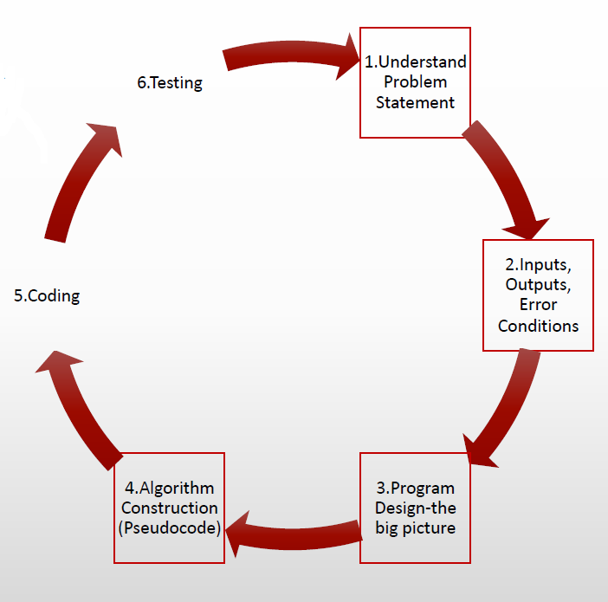
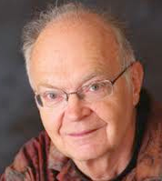
From Design to Implementation
Learn how to convert the algorithm from design to pseudocode.
Pseudo code can be a good way to express your algorithm first.
Programming is about implementing algorithm in java.
from design to code
Algorithms, in general can be expressed as
Flow charts.
Pseudocode.
Program code
“ my general working style is to write everything first with pencil and paper, sitting beside a big waste basket”
− Don Knuth

Slide 4
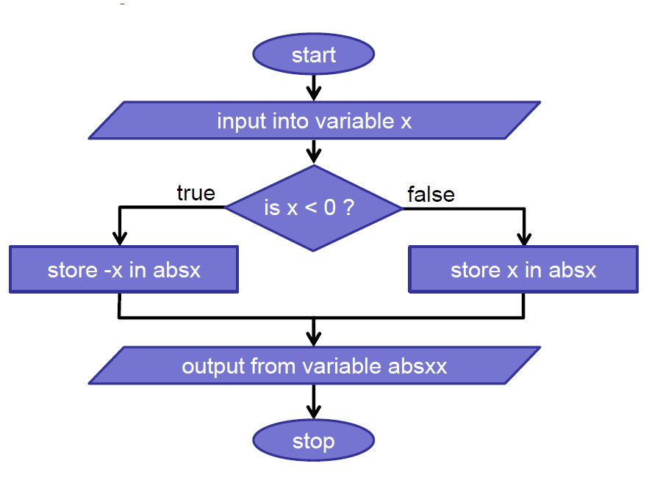
Flow Charts
Flowcharts
Allow organizing control flow more visually.
Check the path of the control based on input.
Change the path based on input.
Example
Read a number.
If the number is positive, then store the number as is.
If the number is negative, store the negative of the number
Notes:
originally designed for consumer electronic devices
used in 3.8 billion cell phones, pcs, secure Java cads, supercomputers, medical devices and other gadgets.
enterprise solutions; "enhanced" web browsing; software on servers; embedded systems; Blu-ray DVD players
http://news.com.com/McNealy+on+message+-+page+2/2008-1010_3-5759831-2.html?tag=st.next

Slide 5
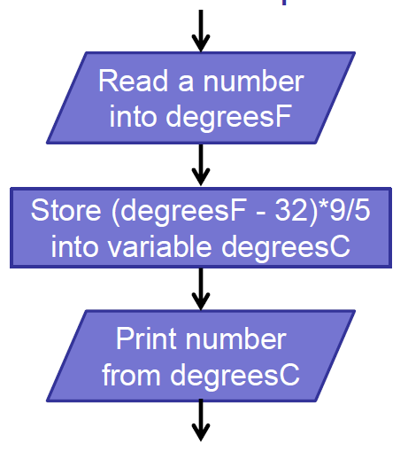
Flow charts, Pseudo code and Program code
flow chart can be a good way to express the algorithm visually
pseudo code is a way to express your algorithm using pseudo instructions
program code is a way to implement your algorithm using Java
READ degF
COMPUTE degC AS (degF – 32)*5/9
DISPLAY degC
double degF;
degF = StdIn.readDouble()
degC = (degF – 32)*5/9
StdOut.println(degC)
from design to code
Flow chart
Pseudo code
Java code

Slide 6
2. Algorithm Implementation and counting
From design to implementation
Adding control flow
Examples of programs
Counting operations
Measuring performance

Slide 7
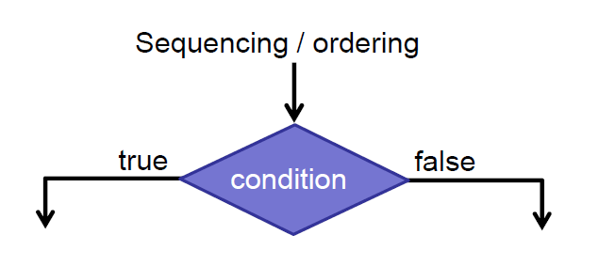
Adding control flow
Programming
Writing logical instructions to perform computation.
Programs execute instructions sequentially by default.
Control flow enables programs to take different paths.
Challenges
learn how to think of control flow.
understand the semantics of various control flows.
Apply them to program instructions
Notes:
originally designed for consumer electronic devices
used in 3.8 billion cell phones, pcs, secure Java cads, supercomputers, medical devices and other gadgets.
enterprise solutions; "enhanced" web browsing; software on servers; embedded systems; Blu-ray DVD players
http://news.com.com/McNealy+on+message+-+page+2/2008-1010_3-5759831-2.html?tag=st.next

Slide 8
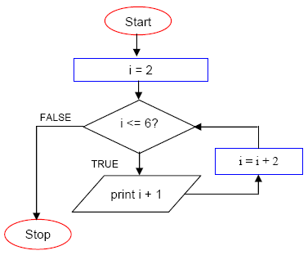
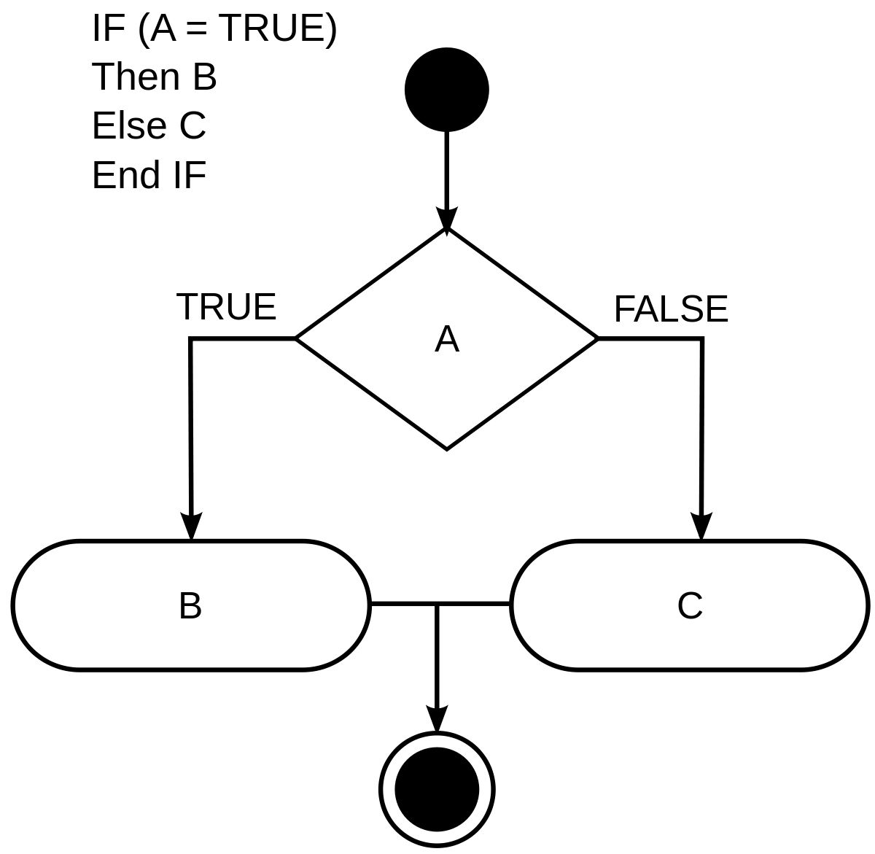
Basic control flow
Branching and Iteration
if-else-statement. Branching based on a decision.
while loop. Iteration while a condition is true.
If-else-statement
while loop
This Photo by Unknown Author is licensed under CC BY-SA
Notes:
originally designed for consumer electronic devices
used in 3.8 billion cell phones, pcs, secure Java cads, supercomputers, medical devices and other gadgets.
enterprise solutions; "enhanced" web browsing; software on servers; embedded systems; Blu-ray DVD players
http://news.com.com/McNealy+on+message+-+page+2/2008-1010_3-5759831-2.html?tag=st.next

Slide 9
2. Algorithm Implementation and counting
From design to implementation
Adding control flow
Examples of programs
Counting operations
Measuring performance

Slide 10
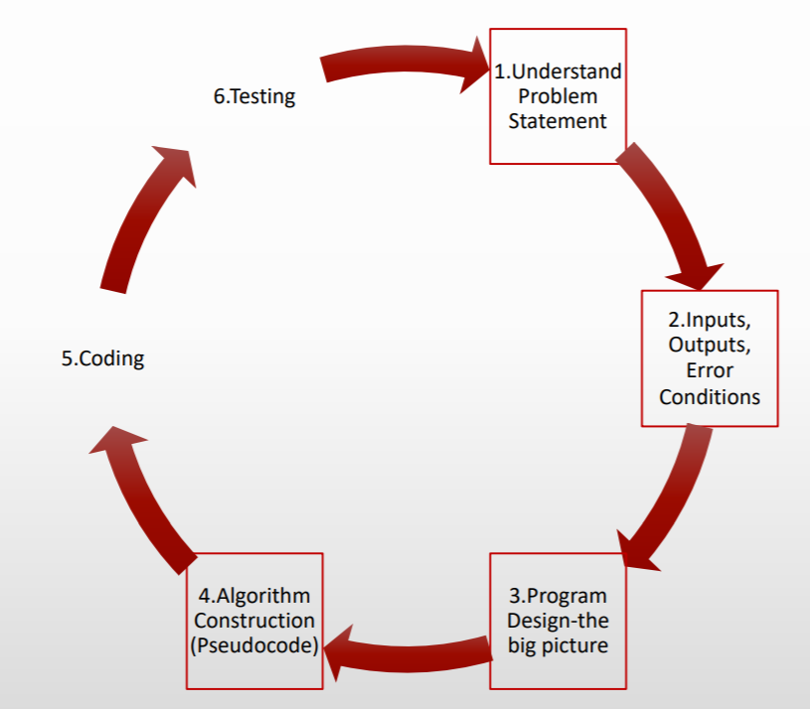
Example Program 1
Problem. Write a program to find the larger of two numbers.
Solution Design. Input: two numbers
Output: larger of the two
Pre-conditions: input can be compared
Test cases: provide [input][output] pairs.
Algorithm.
READ firstNumber
READ secondNumber
IF firstNumber > secondNumber THEN
DISPLAY firstNumber
ELSE
DISPLAY secondNumber
ENDIF

Slide 11
Example Program 2 (with error handling)
LO 2.1
Problem. An algorithm to determine the pay, given the hours worked and rate per hour.
Solution Design. Input, output, error conditions
Algorithm.
READ hoursWorked
READ ratePerHour
IF hoursWorked < 0 OR ratePerHour < 0 THEN
DISPLAY error_message
ELSE
COMPUTE totalPay AS hoursWorked*ratePerHour
DISPLAY totalPay
ENDIF
Test Cases input
[hours worked, rate per hour]
[3, 4.5], [3.5, 4]
[-3, 8], [8, -2]
Good input
bad input

Slide 12
Example Program 3
LO 2.1
Problem. Convert Fahrenheit to Celsius.
Solution Design. Find out what inputs are needed.
Determine error conditions (if any)
(Absolute zero is the lowest possible temperature where nothing could be colder, and no heat energy remains
in a substance. Input should not be less than -457.67F)
Determine the output.
Test the program.
ALGORITHM:
READ degreesF
IF degreesF < -457.67 THEN
DISPLAY ERROR: Temperature must be greater than or equal to -457.67
ELSE
COMPUTE degreesC AS (degreesF – 32) * 5/9
DISPLAY degreesC
ENDIF
TEST CASES:
[input][output]
[32][0]
[-457.68][error]
[-457.67][-273.15]
[65][18.33]

Slide 13
Example Program 4
LO 2.1
Problem. Determine if an integer is even or odd.
Solution Design. Input: an integer
output: number is even or odd
test cases: positive or negative integers
ALGORITHM:
READ number
IF number % 2 IS 0 THEN
DISPLAY even
ELSE
DISPLAY odd ENDIF
TEST CASES:
[input][output]
[-2][even]
[0][even]
[2][even]
[3][odd]

Slide 14
Example Program 5
LO 2.1
Problem. A cake of diameter 6” or less is $10.00. A cake of diameter between 6” and 12” (inclusive) is $15.00. A cake of diameter larger than 12” is $20.00. Find the cost of the cake given the diameter
ALGORITHM:
READ cakeSize
IF cakeSize <= 0 THEN
DISPLAY error
ELSE
IF cakeSize < 6 THEN
SET price AS 10.00
ELSE
IF cakeSize >= 6 AND cakeSize <= 12 THEN
SET price TO 15.00
ELSE
SET price TO 20.00
ENDIF ENDIF
DISPLAY price
ENDIF
TEST CASES:
[input][output]
[-3][error]
[0][error]
[5][10]
[6][15]
[8][15]
[12][15]
[13][20]
[15][20]

Slide 15
2. Algorithm Implementation and counting
From design to implementation
Adding control flow
Examples of programs
Counting operations
Measuring performance

Slide 16
Rules of Counting operations
READ. One operation
COMPUTE. One operation
ADD. One operation
SUBTRACT. One operation
DISPLAY. One operation
SET. One operation
IF. Total number of compares
WHILE. Depends on the number of the iterations (the number of times the loop is executed)
Do not count as operations:
ELSE, ENDIF, ENDWHILE, ENDFOR, HALT

Slide 17
Examples of counting
LO 2.2
Algorithm.
IF hoursWorked < 0 OR ratePerHour < 0 THEN
DISPLAY error_message
ELSE
COMPUTE totalPay AS hoursWorked*ratePerHour
DISPLAY totalPay
ENDIF
2 operations
1 operations
OR
1 operation
1 operation
Example 1

Slide 18
Example Program 6
LO 2.2., 2.3
Problem. Print the positive integers less than or equal to 5.
Solution Design. Input. none
output. integers from 1,2,..5
pre-condition. none
Algorithm.
SET num TO 1
WHILE num <= 5
DISPLAY num
ADD 1 TO num
ENDWHILE
Total operations.
1 + 6 + 5 + 5 = 17
1 operation
1 comparison operation done 5+1 times
1 operation done 5 times
1 operation done 5 times
Notes:
Note: work with a specific value of n to show how to count. Then generalize.

Slide 19
Example Program 7
LO 2.2., 2.3
Problem. Find the sum of the first 50 counting numbers (1 + 2 + 3 + … + 50).
Solution Design. Input: none
Output: the sum 1 + 2 + 3 + … + 50
Pre-condition: none
Algorithm.
SET num TO 1
SET sum TO 0
WHILE num <= 50
COMPUTE sum AS sum + num
ADD 1 TO num
ENDWHILE
DISPLAY sum
Total operations.
2 + 3 * 50 + 1 + 1 = 154
1 operation
1 operation
1 comparison done 50 + 1 times
1 operation done 50 times
1 operation done 50 times
1 operation
Notes:
Note: work with a specific value of n to show how to count. Then generalize.

Slide 20
2. Algorithm Implementation and counting
From design to implementation
Adding control flow
Examples of programs
Counting operations
Measuring performance (optional)

Slide 21
Measuring Performance
Counting Operations
is a way to assess the performance of an algorithm
Each Operation
takes some amount of computer time (in CPU cycles)
Performance of an Algorithm
depends on many variables such as processor speed
Performance of an Algorithm
is typically expressed based on some variable (e.g. data size n) that is only known to the algorithm at the run time.

Slide 22
Example Program 8
LO 2.2., 2.3
Problem. Given an integer n, print the integers from 0,1,2…n . Count the total operations.
Solution Design. Input: the value n
Output: integers from 0,1,2,..n
Pre-condition: number is positive
Algorithm.
READ n
SET count TO 0
WHILE count <= n
DISPLAY count
ADD 1 TO count
ENDWHILE
Total operations.
3 + 3(n+1)
1 operation
1 operation
1 comparison operation done n +1+1 times
1 operation done n+1 times
1 operation done n+1 times
Notes:
Note: work with a specific value of n to show how to count. Then generalize.

Slide 23
Example Program 9
LO 2.4
Problem. Given an integer n, print all proper factors of n.
Solution Design. Input: the value n
Output: all integers that divides n (excluding 1 and n)
Pre-condition: n is positive
Algorithm.
READ n
SET divisor TO 2
WHILE divisor < n
IF n % divisor IS 0 THEN
DISPLAY divisor
ENDIF
ADD 1 TO divisor
ENDWHILE
Total operations.
2 + (n-1) + 2(n-2) + number of divisors of n
1 operation
1 operation
1 comparison operation done n – 2 + 1 times
1 operation done n - 2 times
1 operation done ?? Times (?? = number of divisors of n)
1 comparison operation done n - 2 times
Notes:
Note: work with a specific value of n to show how to count. Then generalize.

Slide 24
Example Program 10
LO 2.4
SET count TO 0
WHILE count <= n
DISPLAY count
COMPUTE count AS count + 1
ENDWHILE
1 operation
1 operation done n + 1 + 1 times
1 operation done n + 1 times
1 operation done n + 1 times
Q. What is the performance of this algorithm in terms of n?
A. 1 + (n+1+1) + 2(n+1)

Slide 25
2. Algorithm Implementation and counting
From design to implementation
Adding control flow
Examples of programs
Rules of counting
Measuring performance

Slide 26
2. Algorithm Implementation and counting
1.1–1.2

